Slide 1
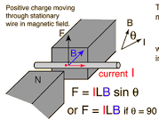
Magnetic Forces in Wires

Slide 2
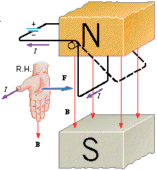
Force on a Current Carrying Wire
$FB=|q|v×B=qvB∙sinθ$ (1)
Let’s assume that the charge $q$ travels through the wire in time $t$.
When Δt is factored in, we obtain:
Where:
(Current)
(Length of wire)
Equation (2) therefore reduces to:
$FB=(\frac{∆q}{∆t})(v∙∆t)×B∙sinθ$ (2)
$$\frac{Δq}{∆t}=I$$
$$v∙∆t=L$$
$$FB=ILB∙ sinθ$$

Slide 3
Force on a Current Carrying Wire vs. a Charged Particle
x x x x x x x x x x x x x x x
x x x x x x x x x x x x x x x
x x x x x x x x x x x x x x x
x x x x x x x x x x x x x x x
x x x x x x x x x x x x x x x
x x x x x x x x x x x x x x x
Note: Right hand rule applies to positively charged particles and conventional current flow, which is the flow of positive charge.
Direction of magnetic field is into the page
F_{B}
v
+
+
Wire of length $L$
Conventional Current
e⁻
e⁻
e⁻
e⁻
e⁻
e⁻
e⁻
e⁻
e⁻
e⁻
e⁻
e⁻
e⁻
e⁻
e⁻
e⁻
e⁻
e⁻
e⁻
e⁻
e⁻
e⁻
e⁻
e⁻
e⁻
e⁻
e⁻
e⁻
e⁻
e⁻
e⁻
e⁻
e⁻
e⁻
e⁻
e⁻
e⁻
e⁻
e⁻
e⁻
e⁻
e⁻
e⁻
Use Right Hand Rule to determine the direction of the force.

Slide 4
Examples #1 & #2
A wire 0.30 m long carrying a current of 9.0 A is at right angles to a uniform magnetic field. The force on the wire is 0.40 N. What is the strength of the magnetic field?
A wire 650 m long is in a 0.46 T magnetic field. A 1.8 N force acts on the wire. What current is in the wire?

Slide 5
Key Ideas
Lorentz Force: A charge moving perpendicular to a magnetic field will experience a force.
Charged particles moving perpendicular to a magnetic field will travel in a circular orbit.
The Lorentz force acts on any charge moving through a magnetic field, even if it is constrained to travel in a wire.
Use right hand rules to determine the relationship between the magnetic field, the current and the resulting force the wire experiences.

